Slide 1
Texas Workforce Commission’s
Education Specialists
Outreach Services We Provide through the Labor Market & Career Information (LMCI) Department
Notes:
Lori- Good afternoon, everyone. Thank you so much for joining us today to discuss the Education Outreach team here at the Texas Workforce Commission (TWC). I am Lori Knight, one of the Education Specialists, and I am eager to share with you the information we will cover today.
Karla- and I am Karla Jasen, the other Education Specialist. I too am excited about the information we will share, and particularly how it will help us to develop and utilize our partnerships with the workforce boards and the numerous Workforce Solutions offices and staff around the state.
Lori- Absolutely, Karla. Would you like to tell listeners the topic we are covering today?
Karla- Sure! In a moment we will explain the specific outreach services that our team provides through the Labor Market and Career Information department here at TWC. A division we refer to as LMCI.
Lori- That sounds great, but before we get started, Karla, I wanted to take care of some housekeeping announcements for our listeners so they understand how the webinar will be conducted today and how they can access this information later to share with colleagues who may not be able to join us as we stream the webinar live today.
Karla- Sounds great. Let’s do it.

Slide 2
Before We Get Started
Housekeeping
Brief Announcements
Type questions in Q&A box
24-48 hours for more ?s
We will post to our website:
  Webinar recording
  Q&A Transcript
  PowerPoint file
Working on a lot of projects this summer
  We need your help on some
Many new/fresh resources to come
Notes:
Lori- During the presentation, we will not be able to stop and answer questions, but I highly encourage you to post questions you come up with in the Q&A box of this webinar as the presentation progresses.
At the end of the demonstration, we will read and respond to each question.
Karla- Right, but if you have any further questions after the webinar is completed, please feel free to email those to us, within about 24-48 hours, at the email address provided at the end of this webinar, and we will respond to them as soon as possible.
Lori- We will take all of the questions provided in the Q&A box, as well as those sent to us later, and will transcribe the responses. The resulting Q&A sheet will then be uploaded as a pdf, along with a recording of this webinar, to the Texas Workforce Commission’s LMCI website.
This is why there is a two-day deadline for questions. Users can then access these at any time to rewatch the webinar or review questions at their leisure.
Karla- Thanks, Lori. I wanted to take a moment to mention a couple of other items before we move on to the webinar.
First, I want to let you know that Lori and I will be working on some new and exciting projects this summer in the hopes of creating some great resources for our audiences. There is more information to come on a couple of those later.
Lori- We also have some revamped online resources coming soon to our website as well. In fact, LMCI will reveal a new facelift to our department website very soon, and it will provide a unique and more user-friendly experience to all of our audience groups; and Texas CARES is currently experiencing a long-awaited overhaul that will be released on our website in mid-July, so keep your eyes out for that. In fact, we will offer more webinars in the future to feature those updates. (And I want to say a quick shout out to the LMCI IT department for doing such an amazing job on all of their projects. Under the guidance of Mark Duksta, the IT team has been able to accomplish so much while keeping a strict eye on quality, encouraging and utilizing feedback from our users that Karla and I continually bring back from the road, and creating user-friendly and aesthetically pleasing products. Great job, guys. We are so impressed and thankful for your work).
Karla- Ok, Lori. I think the audience is ready for the webinar. Let’s get started.

Slide 3
Objectives:
Introduce the TWC Education Outreach team
Describe our services
Offer to share our materials
Request your help
Notes:
Lori- The objectives for the webinar today are to introduce all of our listeners to the TWC Education Outreach team.
Karla- We will also take the time to describe our services and target audiences.
Lori- We plan to offer the opportunity for you to share our education/training materials, and we will tell you how to get them.
Karla- and finally, we will send out a call for help on a couple of projects we are putting together for the summer. We will explain what we’re doing, how you can help, and provide our contact information for those in a position to offer assistance.

Slide 4
How We Are Organized
TWC
LMCI
Education Outreach
Roni Downey
Mick Normington
Lori Knight
Karla Jasen
Business Outreach
Notes:
Karla- Before we move on to the introductions, I think we need to provide our audience with a visual description of where our team fits in the organization of the commission.
Lori- As you can see in this primitive flow chart, the LMCI department is just one branch under the larger umbrella of the Workforce Commission office in Austin Texas. Within the LMCI department, there are two outreach teams. One that focuses on business outreach and one that focuses on Education outreach. I know that many of you listening are very familiar with our Business Outreach specialists Roni Downey and Mick Normington. You will see that many of our services are similar though we do have a different audience base, and our training-of-trainers approach is another noted difference.
Karla- We wanted to first point out the similarities to help you put the right perspective and expectations on the information we share with you today. With that said, now I think it’s time for you to meet the team.

Slide 5
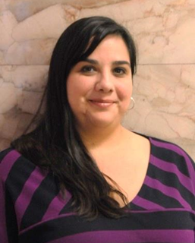
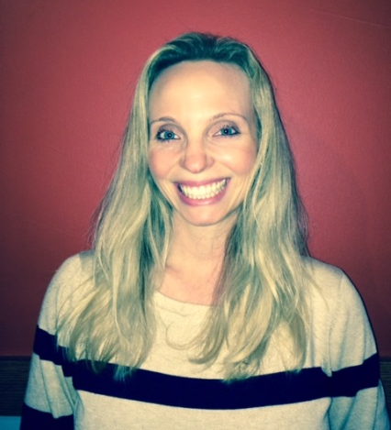
Meet Our Team
Focus = Education Outreach
All previous educators
Varied education experience
Build education/workforce partnerships
Lori Knight
Karla Jasen
Notes:
Lori- I am Lori Knight, and I have been a part of the Education Outreach team since the summer of 2014.
Karla- I am Karla Jasen, and I have been on the team since January 2016.
Lori- Obviously, there are two members on this team. Though we have varied backgrounds with vast experiences in several different industries, we are both previous educators who at some point each served middle and high school students; while I also taught college-level students as well.
Karla- In addition to our roles as educators, collectively, we also have experience as collegiate academic advisors, student advocates, and Program Coordinators. In our positions as TWC Education Specialists, we get to leverage much of our expertise and skill when working with our education audiences.

Slide 6
Who We Serve
(In Alphabetical Order)
Adult Education & Literacy Staff
AE&L Students
CTE Administrators and Faculty
Counselors
ESC Region Staff
School Administrators
Students and Parents
Teachers
Transition Staff
Workforce Boards
Workforce Solution Offices
Workforce Solution Staff
Notes:
Lori –Yes, we do, Karla, and let’s talk about those audiences we serve currently. As the list here indicates, we serve a vast educational audience; from students and parents, to teachers, counselors, administrative staff, transition staff who serve special populations, Education region-level staff, and Career and Technical Education faculty, staff, and administrators.
Karla- Right, but we also want to start expanding our outreach to include more partnerships with our Workforce Boards and Workforce Solutions offices, especially in regard to participating in local and regional career fairs for students.
Lori- Let’s tell them about the services we offer these audience groups so they can better understand how they can leverage our team for the awesome work they are already doing.

Slide 7
Our Services
Presentations or large assemblies
Professional development, in-service sessions
Hands-on, collaborative LMCI tool training sessions
Training-of-Trainers
Career Day presentations at schools
Career Fair information tables: including our selfie booth at schools or in communities
Tailored to each audience
Notes:
Karla- Currently, we interact with our audiences in many different ways. Much of our time is spent traveling the state to provide presentations to both large and small student or staff and faculty groups. We also facilitate professional development experiences through Education Service Center Region area in-service events as well as hands-on-training sessions to learn how to use our LMCI tools.
Lori- So far, these services probably sound very familiar because they are similar to the kinds of encounters you have had with our colleagues Roni and Mick, for many years. But here is where our services are tweaked to be just a little bit different.
In addition to providing these presentations or professional development training sessions, we can also put together some training-of-trainer events to help your Workforce Solutions staff to teach others how to facilitate their own presentations or trainings.
Karla- And the way we participate in career fairs, expos, and career day events throughout the state is also a little different. We attend the career fairs that focus on students or youth seeking jobs. We not only offer informative materials at our career fair tables, but we also bring with us an interactive selfie booth to offer participants an engaging career fair experience.
Lori- No matter what services you are interested in utilizing, the best thing about our services is that they can be easily tailored to meet the specific needs of each individual audience. And just in case you’re asking yourself right now, “Exactly what is a selfie booth?” Karla is going to take a moment to tell us.

Slide 8
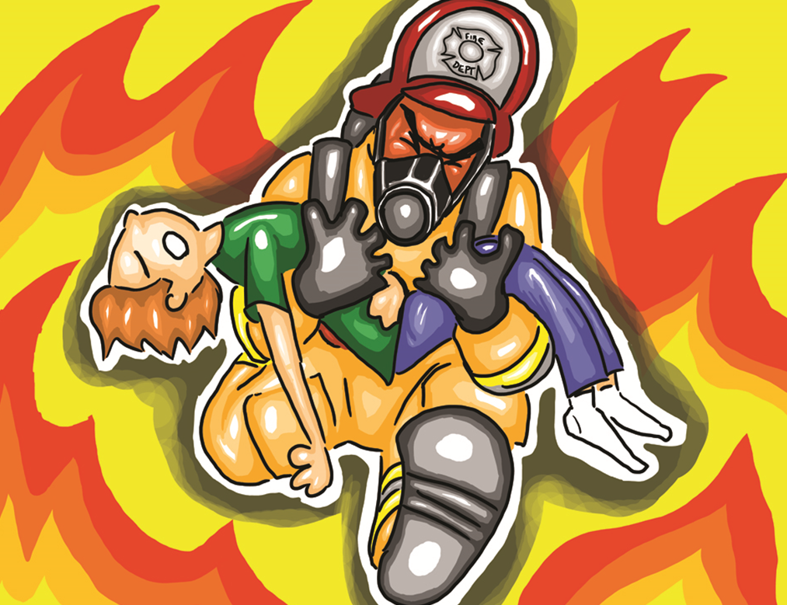
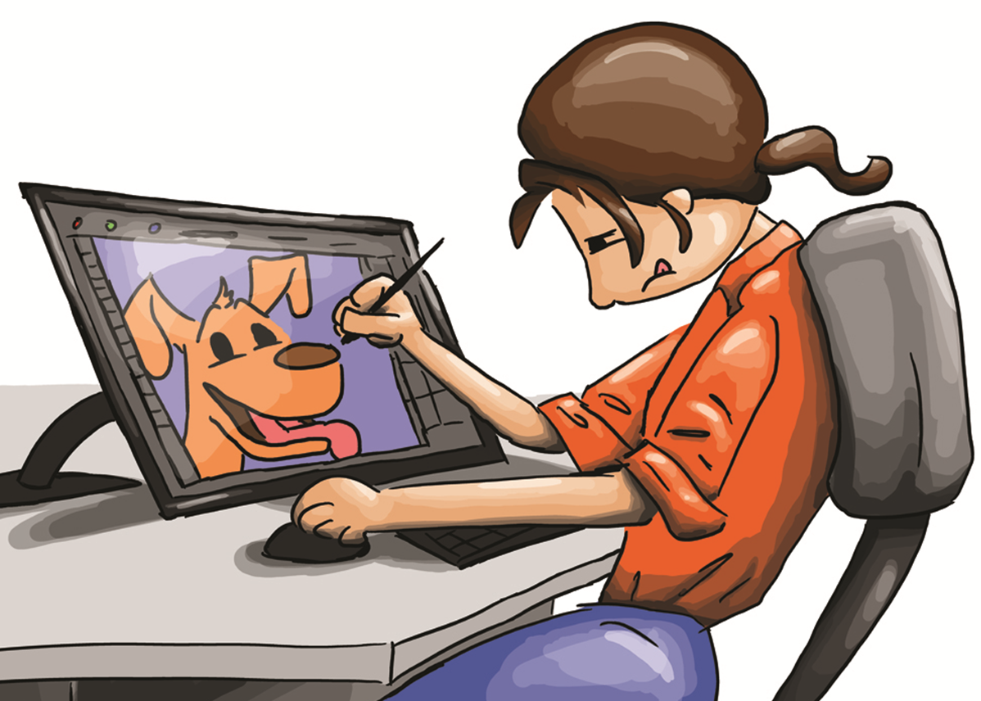
What is Our Selfie Booth?
Firefighter
40+ Animated Caricatures
On 16x20 foam board
Faces removed for users
Allows a “try-on” of jobs
Multi-Media
Artist
Architect
Notes:
Karla- Right. So, our selfie booth consists of two parts; a backdrop and over 40 16x20 foam-core boards that each feature caricatures in different occupations.
The only additional piece participants need to interact with the selfie booth is a way to capture their own photos as they position their heads within each board in place of the career characters.
This opportunity not only allows users to easily and quickly “try on” as many of the different careers as they want to, but it also provides a fun opportunity to learn about the different jobs as each board is equipped with career information and labor market data.
For younger audiences, teachers tend to use their own cameras or smart phones to collect individual photos of their students, or classroom group photos.
Lori- We decided to take some photos of our colleagues using the selfie boards to demonstrate how they can be used with students. Here are a few photos to show you some of the fun we had with them.

Slide 9
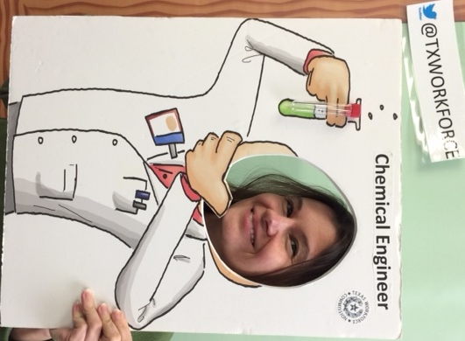
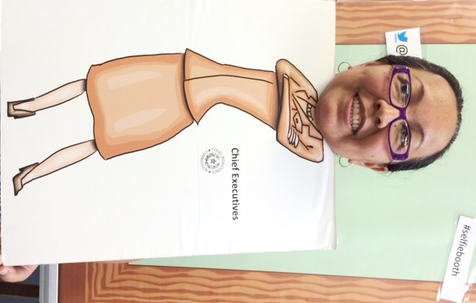
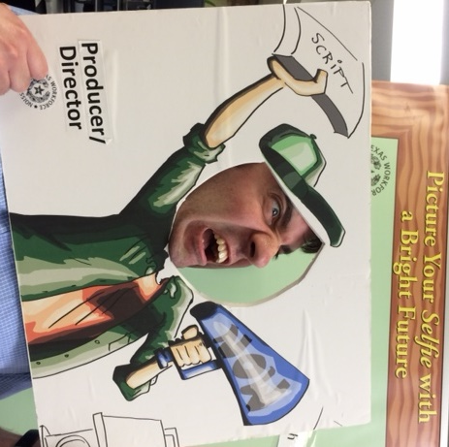
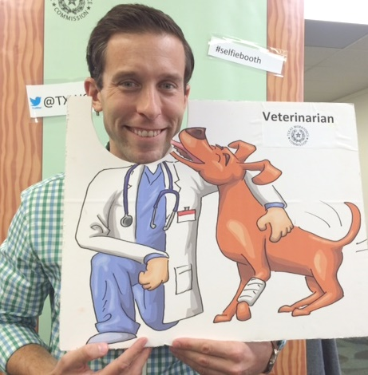
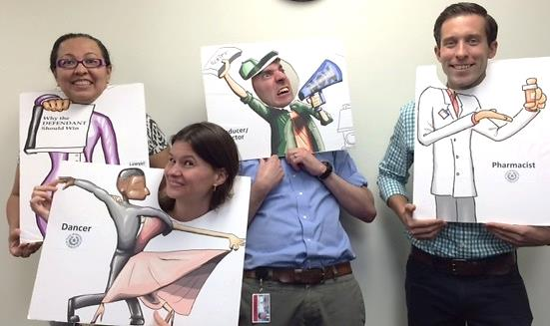
Some Fun with the Selfies
Notes:
Lori- These career cartoons were created, in-house, by our co-worker Mark Lavergne who you see here modeling our Producer/Director cartoon. As you can see, Mark seems to be stressed out by this job, but so far, we have received nothing but great feedback from students in regard to our selfie boards, and they seem to really enjoy them.
Karla- As you can see in these other photos, our co-workers also had a lot of fun with them, and who wouldn’t want to be a veterinarian after seeing Matt Weber with this selfie board?
Lori- Right? And you may be asking yourself, “how could these selfie boards possibly get any better?” Well, here’s how.

Slide 10
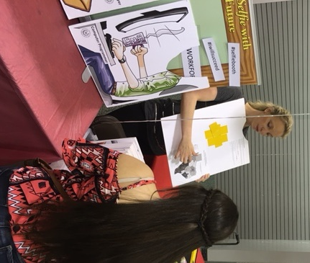
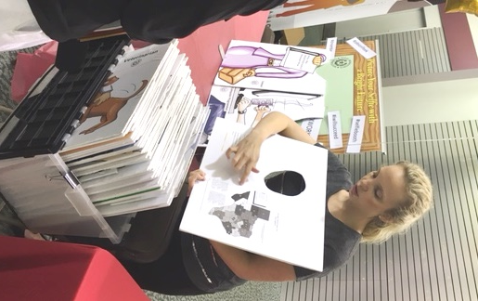
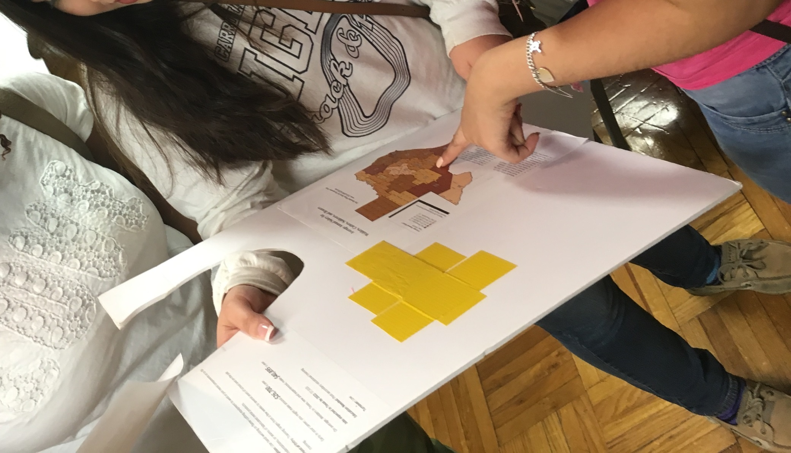
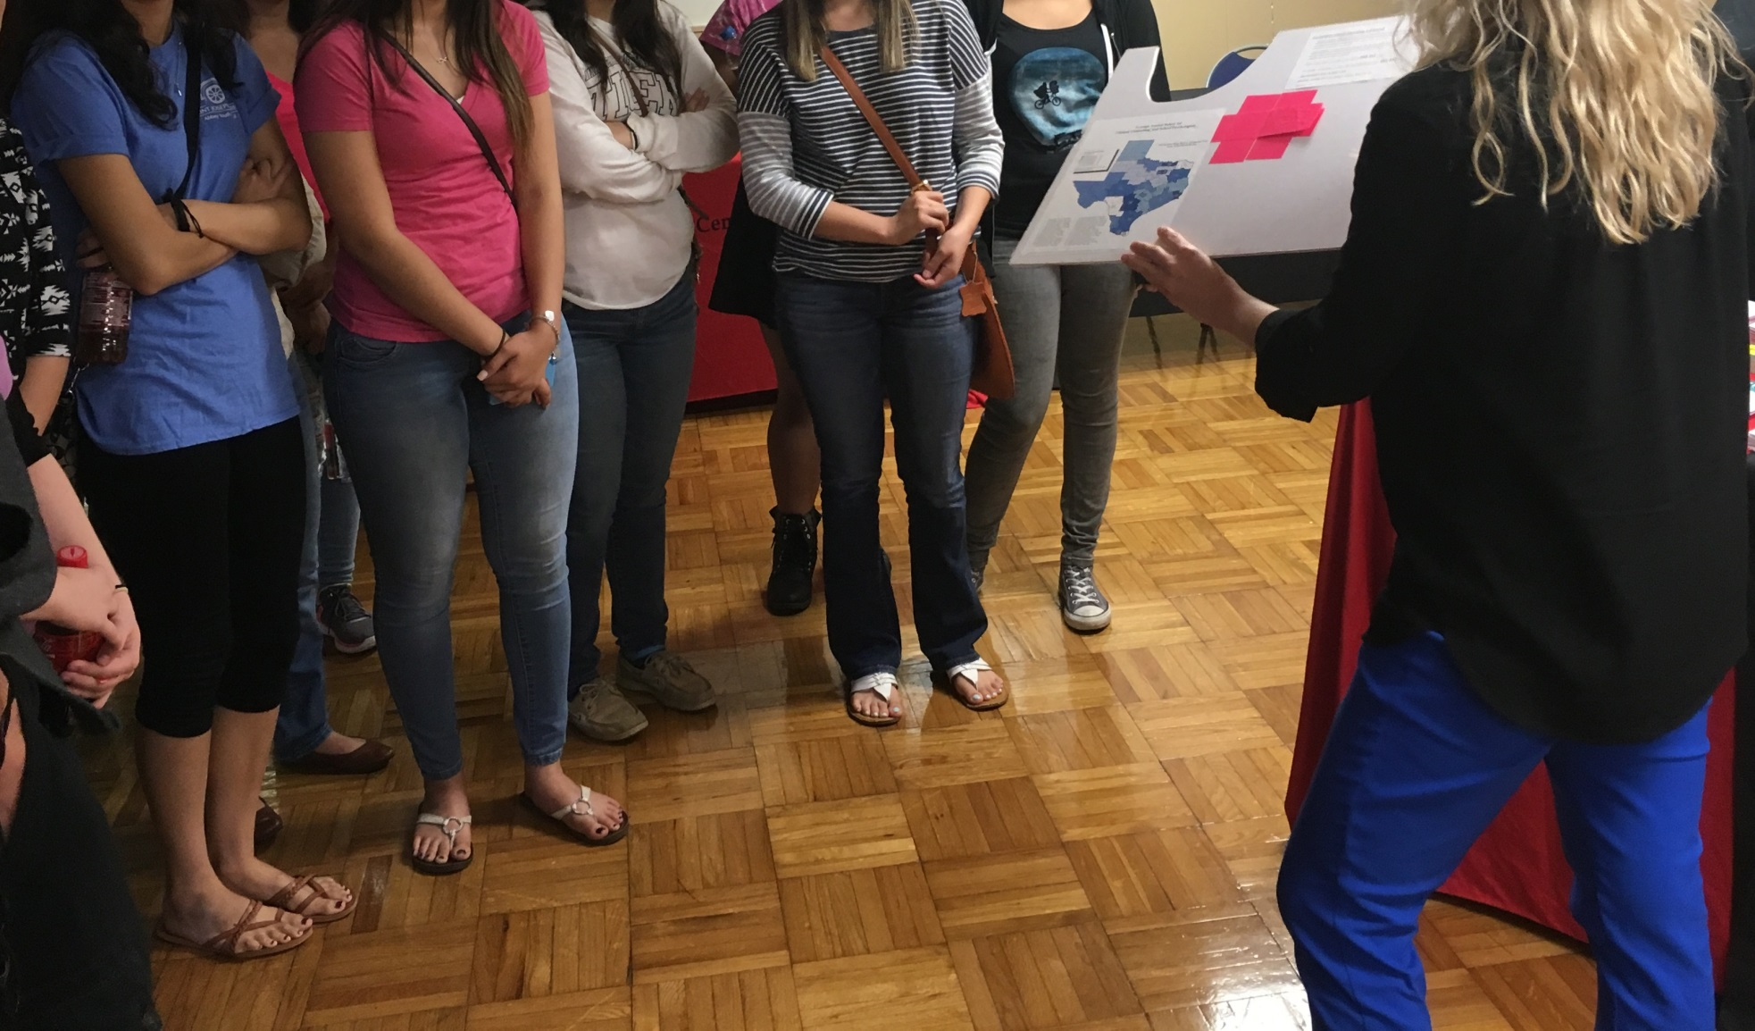
Selfies Used to Teach
Notes:
Karla- In these photos, I am showing students the back of the selfie boards where we have included all kinds of labor market information about each of the jobs featured on the front of the boards.
Lori- That’s right, and we encourage students to now only snap cute photos of themselves as these career caricatures, but we also remind them to flip the boards over and snap pictures of the information on the back of the careers they are interested in.
In fact, this is a photo taken at a recent career fair in Kingsville coordinated by the Costal Bend Workforce Board, and yes, those are students pouring over the information on the back of one of our selfie boards.

Slide 11
How do Our Services Help You?
Staff
Workforce Solutions Clients
Teach LMCI product use
Promote data-driven career decisions
Engage career fair audience
Facilitate career readiness workshops
Use LMCI resources
Make informed career decisions
Learn workforce realities
  Need for career mapping
  Soft Skills
  Find, get, and keep a job
Notes:
Karla- You may be wondering how can our services benefit you. We believe through our presentations, in-service events, or trainings, we can help your Workforce Boards and Workforce Solutions Staff to:
Learn how to use all of our LMCI tools and products
Facilitate conversations with job seekers that promote data-driven career decision making
Create their own selfie booths to offer engaging career fair experiences when attending local fairs
Promote workshops for the job seekers that visit their offices
Lori- We also think our services can benefit your clients if you prefer to have us come visit and facilitate presentations or workshops. In this way, we can help job seekers in your area:
Learn how to use all of our LMCI tools and products
Apply the information they collect in our tools to make better-informed career decisions
Learn and understand workforce realities and how they apply to their job search and ability to thrive in the workplace. Our workshops can teach them content such as:
Why long-term career planning is helpful and essential
Soft Skills
How to find, get, and keep a job

Slide 12
Train-the-Trainer
We Can Show Workforce Staff how to:
Train other staff in their offices to:
  Use all LMCI resources and data
  Coordinate and facilitate workshops for clients
  Teach career research methods
Notes:
Karla- Through our training-of-trainers events, we can take the benefits of our services one step further by sharing our expertise in a way that allows training participants to take this knowledge back to share with their colleagues.
Specifically, we can show workforce staff how to train their co-workers to
Use all LMCI tools and resources
Coordinate and facilitate workforce center workshops for clients
Teach career research methods to clients to promote solid decision-making processes.

Slide 13


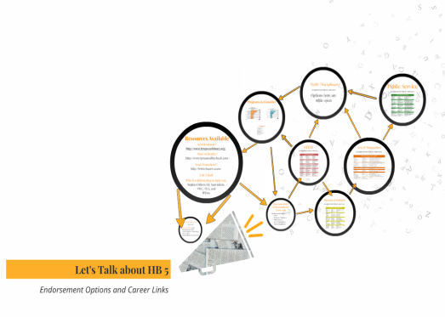


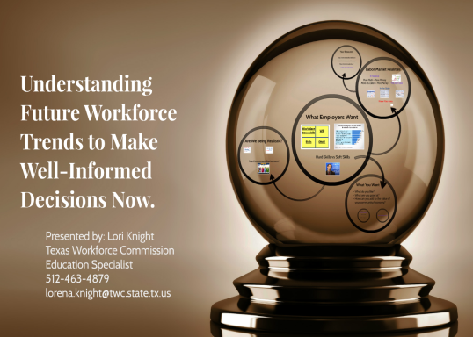

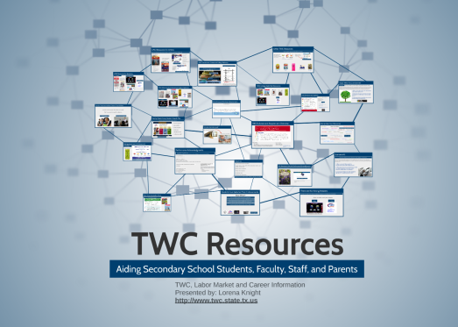
We’ll Even Share Our Presentations with You
If you want them
Use our data and research
Use for workshops
Notes:
Lori- When we visit your sites, we will even leave behind our presentations to share with you if you need or want them. We want you to let our expertise, research, data, and visual aids be a starting point for interactions you have with your clients, or use them in center workshops.

Slide 14
Great news…
This is all FREE!
We offer these services at absolutely no charge to you or your offices.
Not Charged for:
You Can Help with:
Our travel
Our lodging
Our meals
Materials
Coordination of event
Venue
Training Supplies
Notes:
Karla- Because the partnerships between the commission, our boards, and all of our Workforce Solution Offices are critical and so integrated, we offer all of services at absolutely no cost to you. This means there is no charge to you for our travel, lodging, meals, or the LMCI materials we bring with us.
Lori- The only assistance we will ask for is when the events you coordinate serve a very large number of people. In those cases, we assume that members of your team will already be working on the coordination of your event and securing a venue to hold it. If that is not the case, please let us know and we can discuss what we can do to help this part along.
Karla- Other than that, it would be great if the Workforce Solutions offices could also be in charge of helping to provide training materials such as whiteboard markers, flipcharts, or pens and paper for example, as that would help ease the load of materials we must travel with.

Slide 15
Interested?
What we need from you:
  3 weeks advanced notice
  Date
  Time and duration
  Physical location
  Intended audience
  Number attending
Notes:
Lori- If you are interested in having us come out to your area to provide any of these services, we request that you contact us at least 3 weeks in advance of the event with the following information to get the travel request process started:
Date of the event
The start time and expected duration of the event
The physical location where the event will be held
Knowledge of who the intended audience present will be
Estimated number of attendance expected
Karla- Please keep in mind, our calendar fills up rather quickly, but with 2 specialists available, we are hoping this will allow us to accommodate more requests.
Also, there is a process we must complete in order to obtain agency approval to travel so give us about a week’s time after the initial contact before we can confirm any dates with you.
Lori- Right. Those are our services and how we think they can be beneficial to the workforce boards and Workforce Solutions offices. Remember, if you have any questions about anything we have shared so far, please type those into the Q&A box on the right of this screen, and we will get to those at the end of the presentation.

Slide 16
How You Can Help Us
Best-Practices
People to Interview
We’re putting together an online resource
  All ESC and WDA “best” partnership programs
Tell us who would know this for your area
Tell us your best-practices
We need to interview people in different occupations across the state.
  To share with students
Who can connect us with people to interview?
Notes:
Karla- There is one additional topic we would like to discuss, and that is how you, our partners in the WDA areas can help us on a couple of projects we are working on this summer.
Lori- Absolutely! Karla and I will be working on putting together an online resource which will showcase the best programs throughout the state that highlight education and workforce partnerships. Karla will work on collecting this information from our workforce partners, and I will work on collecting the information from our Education partners.
Our goal is share this resource with both audiences (workforce and education) when it is complete. We decided approaching it separately, from both angles would ensure we don’t miss anything.
Karla- With that said, we were hoping that you, our audience, could tell us who, in your regions, on your boards, or in your offices would know which programs in your area should be featured in this resource.
Whether you are inclined to reach out to Lori or I to provide us with those names, or just send us information on the programs that you think highlight your best practices to partner workforce and education, we encourage and welcome any information you are able to pass along.
Lori- Another project I will be working on this summer will require me to interview approximately 100 people across the state in different occupations.
Our purpose is to collect this information to share with students by expanding our popular publication Why Study This? into a series of publications students can access in print or online.
In order to this, I have identified the 100 occupations we want to focus on, but are hoping to find the right people to interview and to ensure that we touch all of the 28 WDAs when locating people to feature.
Karla- Lori is hoping that some of you listening can connect her with people in your regions who would be interested in taking a look at her list of job titles and finding anywhere between 3-4 occupations to focus on, then finding her the individuals to feature in this publication who would like to talk to her about their jobs and the education they earned to do those jobs.
Preferably, she is looking for individuals who have regular communication with employers, community workforce individuals, industry leaders, or workers in the community to help her get these interviews underway.

Slide 17
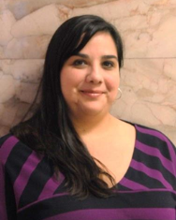
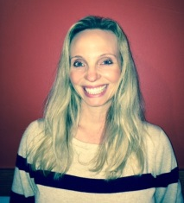
Contact Information
Lorena Knight (Lori) 512.463.4879 lorena.knight@twc.state.tx.us
Karla Jasen
512.936.3193
karla.jasen@twc.state.tx.us
Or email our shared account at:
careerinformation@twc.state.tx.us
Notes:
Lori- Absolutely! Whether you are reaching out to us to request our services, or to help us with one of our summer projects, please use the contact information here to get a hold of us.
My direct phone number is 512-463-4879 and my email address is Lorena.knight@twc.state.tx.us
Karla- and my direct line is 512-936-3193 and my email address is karla.jasen@twc.state.tx.us
Lori- Or, to make sure we both get the message, you can email our shared email address at careerinformation@twc.state.tx.us

Slide 18
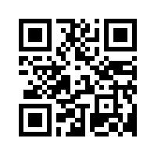
Want to be notified?
To be added to our mailing list:
  Email careerinformation@twc.state.tx.us
  Call our hotline 1-800-822-PLAN (7526)
You will get notifications regarding:
  Publication releases/updates
  Software releases/updates
  Webinar announcements
To receive TWC legislative updates
  Scan the QR code on the right
http://bit.ly/YUB3cD
Notes:
Karla- In the meantime, if you would like to:
Receive information on what we working on
Order our products or our free Counselor packets (which are available for all academic staff and faculty, not just Counselors) or
Sign up for webinar or newsletter notifications
Email us at: CareerInformation@twc.state.tx.us .
Lori- Be sure to provide your name, email, and physical mailing addresses to be added to our mailing list or to receive any ordered products.
You can also call our 24-hour, toll-free hotline at 1-800-822-PLAN (7526).
Students, parents, Counselors, and Teachers can call to request labor market information on careers or in-depth profiles on colleges and universities in the U.S.
Karla- Use any of these methods to receive notifications on future publication releases or updates, release or update announcements for any new online tools or software we create, and announcements of future webinars.
Lori- You can also sign up to receive Texas Workforce Commission and Foundation High School Program endorsement legislation updates by going to the URL on this screen or by scanning the QR Code below.
You will be taken to a webpage that asks for your email address.
This link will allow you to be added to the TWC’s main mailing address list.
Karla- Keep in mind, the QR code on the right provides information and announcements for all TWC releases and updates, including but not limited to, what we are working on.

Slide 19
Want the Archived Webinars?
Follow this link: www.lmci.state.tx.us/counselors/presentations/presentations.asp
Or go to the Counselor/Teacher section of the LMCI website at www.lmci.state.tx.us
  First resource link on the left
Keep an eye out for future webinars
Notes:
Lori- If you are interested in watching (or rewatching) any of our archived webinars, you can access them one of two ways:
Follow this link: www.lmci.state.tx.us/counselorspresentations/presentations.asp
Or enter the Counselor/Teacher page of our LMCI website by going to www.lmci.state.tx.us.
The link to the webinars will be the first resource listed on the left side of the page.
Karla- Please be on the lookout for another webinar invitation from us this summer, as we are VERY excited about some upcoming website and resource updates that will be finalized very soon. Once those are ready for release, we will have another webinar just like this one, and believe me when I say, you won’t want to miss it.
Lori- Remember, if you want to receive those webinar notifications, be sure to email us to be added to our mailing list.
Lastly, if you have any webinar topic recommendations or requests for future sessions, please feel free to send those our way via email as well.

Slide 20
Time For Q&A
Thank You
Have a great day!
careerinformation@twc.state.tx.us
Notes:
Karla- At this time, I want to thank you for joining us today for this webinar. That concludes our presentation and we will now review the questions or comments provided by the audience via the Q&A box and will respond.
Lori- Remember, if you have any other questions or comments within the next 24-48 hours, please feel free to email those to us at the email address provided and we will add them to the Q&A form. This document, alongside the recording of this webinar will be posted to the TWC website as soon as we can have it added.
Ok, Let’s get to some of these questions.
Q&A:
We will read questions and provide answers as needed.
Conclusion of Webinar:
Lori- Thank you for your time, everyone, and your great questions. That concludes the webinar for today.
Have a wonderful day.

